Slide 1

Report for BFX-AT100 – LED Issue
FOXCONN CPEG JBD_VN
May 16, 2022
Listens to customers, Meet customer expectation

Slide 2
D1. Establish the Team
Team Leader
Team Member
Foxconn
  PM: Ben
  QA: Toney Tu
PM: An Tran
QA: Rachel, Robert Wu
PD: Wen Yong
SQE: Chun Ke
PE: Michel, Nam
Listens to customers, Meet customer expectation

Slide 3
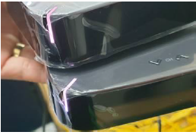
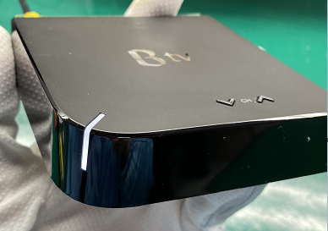
D2. Description of Problems
Issue Description
On Mar 29, 2022, Customer complained that the LED color of 2 units of BFX-AT100 model was abnormal.
Customer has complained LED (yellow & purple) issue before, on Feb-2021; the root cause is LED material issue and Everlight vendor has provided 8D report for this case.
On 04 May, 2022, Fii received 2 Led color issue units (Pink color) from ALT customer
Detail information as below:
NG Units-Customer image
OK Unit
Summary: The led color is mixed white and pink color.
Listens to customers, Meet customer expectation

Slide 4
D3. Containment
Check DC & LC data of LED issue
No | Shipping SN | Foxconn SN | DATE_CODE | Production date | LOT_CODE | Vendor
1 | 21496880012022011126654 | YWO1H3Y | 210831 | 2022/02/24 | Y210831E6001KFFWX31 | EVERLIGHT
2 | 21496880012022011126732 | YWO1F6Y | 210831 | 2022/02/24 | Y210831E6001KFFWX31 | EVERLIGHT
As long-term solution of Everlight vendor ,they improved LED issue from 2021/06/20; DC: 20210620.
2 NG units belong 2021/08/31; DC:210831, Everlight has improved the LED issue in DC: 210831 but it is still issue in customer side.
Owner: SQE/ Chun Ke – Done Mar/29
Fii Holds DC: 210831.
Request SQE holds 55800pcs LED in stock belong DC: 210831
Owner: SQE/ Chun Ke – Done Mar/29
Listens to customers, Meet customer expectation

Slide 5
D3. Containment
Check production history and inventory.
Check production history: Every Light shipped total 244k DC: 210831 to Fii from Nov 11, 2021 to at the present.
Fii used 188k and there are 55800pcs in stock.
Owner: SQE/ Chun Ke – Done Mar/29
  Feedback Everlight vendor for analysis
SQE requests Everlight for further analysis.
Owner: SQE/ Chun Ke – Done Mar/29
Listens to customers, Meet customer expectation

Slide 6
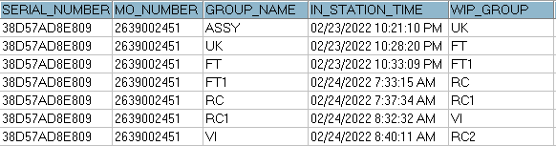
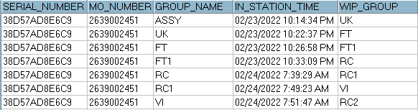


D4. Root Cause
1. Fii check production data.
Check production data of 2uints did not find abnormal.
SN: 21496880012022011126732
21496880012022011126654
Check log test of 2 units at FT1 station, they are passed “check LED” item.
Summary:
Two units passed all station normally.
Led color issue can cover at FT1 station.
Listens to customers, Meet customer expectation

Slide 7
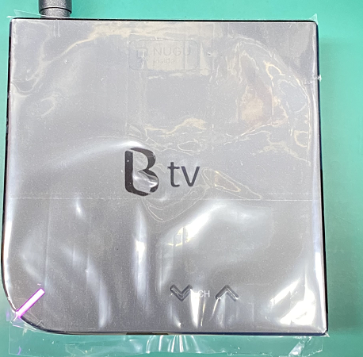
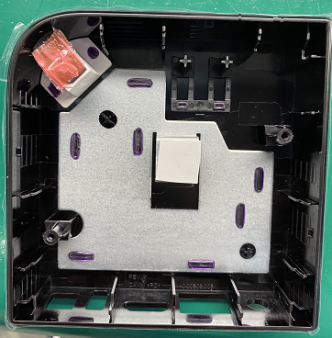
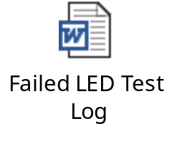
D4. Root Cause
2. Fii check Led issue coverage.
2.1 Fii do experiment -1 to check LED coverage
Stick a pink plastic film on the light guide bar then assemble normal PCBA and bottom cover.
After that plug power cord ( the LED color is mixed white and pink status) and test unit at FT1 station.
The result is failed at check LED item.
Listens to customers, Meet customer expectation

Slide 8
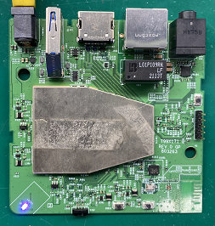
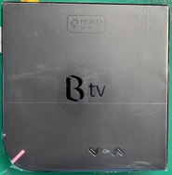
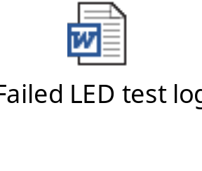
D4. Root Cause
2.2 Fii do experiment -2 to check LED coverage
Chose 1pcs NG LED, and mounted on the good PCBA. then assemble housing.
After that plug power cord and test unit at FT1 station.
The result is failed at check LED item.
Summary:
LED color issue can cover 100% at FT1 station.
Listens to customers, Meet customer expectation

Slide 9
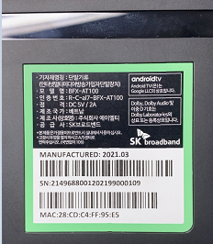
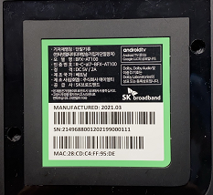
D4. Root Cause
3. Fii received 2 units and opened for analysis
3.1 Fii visual inspection
After received, Fii inspected and found the SN on housing label is mismatch with the SN which customer feedback.
After confirmed with customer, RMA center changed the bottom case.
No | Customer feedback device SN | Fii received device SN
1 | 21496880012022011126654 | 2149688001202199000109
2 | 21496880012022011126732 | 2149688001202199000111
The actual SN and device housing Fii received from customer.
Listens to customers, Meet customer expectation

Slide 10
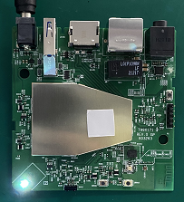
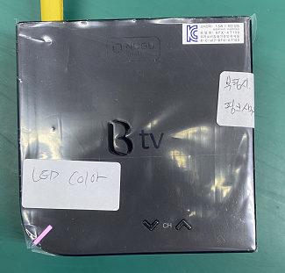
D4. Root Cause
3.2 Fii opens housing and inspects PCBA
After opened, Fii inspected Led location and did not find any abnormal, then Fii plugged power cord in PCBA to check Led color and detected Led color is normal with white light.
After that, Fii reassembled PCBA into housing and plugged power cord in device to check and detected Led color is abnormal with pink light
LED light normally on PCBA
LED light abnormally – Purple color
Listens to customers, Meet customer expectation

Slide 11
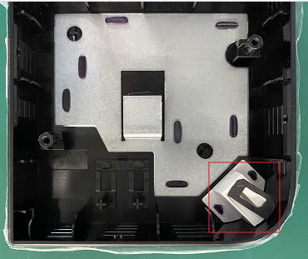
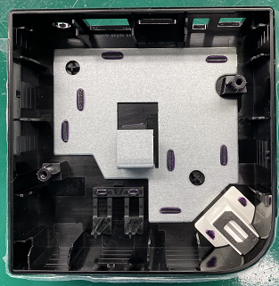
D4. Root Cause
3.3 Fii opens device and inspects housing
After re-opened, Fii found the sponge was misalign on the top case.
Sponge misalign
LED pad OK
Listens to customers, Meet customer expectation

Slide 12
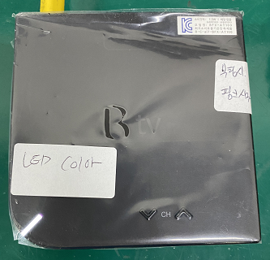
D4. Root Cause
3.4 Fii adjusted sponge and reassembled
Fii adjusted sponge in correct location and reassembled.
Then Fii plugged power cord in device to check Led color again and detected Led color is normal with white light.
Sponge OK
LED light normally
Listens to customers, Meet customer expectation

Slide 13
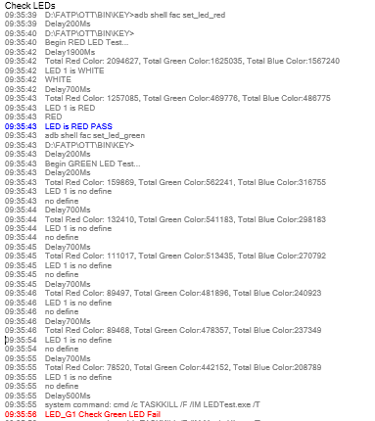
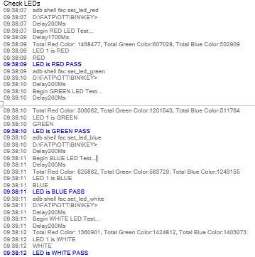
D4. Root Cause
3.5 Fii makes experiment and retest at FT1 station
Fii makes experiment with 2 cases and retest at 5 times at FT1 station
- Case 1: Assemble PCBA into housing pasted misalign location of sponge.
- Case 2: Assemble PCBA into housing pasted correct location of sponge.
Test Machine Name | Case 1 |  | Case 2
 | NG1 Unit | NG2 Unit | NG1 Unit | NG2 Unit
L10T99FT1001 | Fail | Fail | Pass | Pass
L10T99FT1002 | Fail | Fail | Pass | Pass
L10T99FT1005 | Fail | Fail | Pass | Pass
L10T99FT1009 | Fail | Fail | Pass | Pass
L10T99FT10012 | Fail | Fail | Pass | Pass
Remark:
- Fail: Green LED test fail
- Pass: All LED test pass
Green LED Fail
LED Pass
Listens to customers, Meet customer expectation

Slide 14
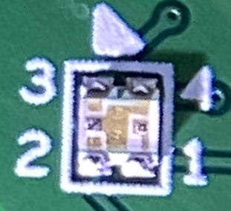
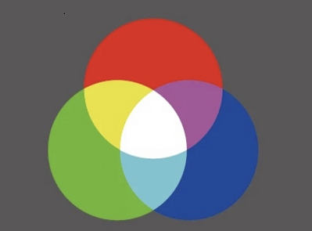
D4. Root Cause
3.6 Led color explanation.
The white color light is a combination of Red, Green and Blue Led (Pin 1,2 and 3).
However, in this case, Green Led (Pin 2) was covered by misalign Sponge lead to Led color is pink light because pink light is the combination of Red and Blue Led (Pin 1 and 3) as picture 2.
Green LED is covered
LED displayed
Sponge misalign
Purple LED
Picture 1
Picture 2
Picture 3
Picture 4
Remark:
Pin 1: Red Pin 2: Green
Pin 3: Blue Pin 4: PP_PWR_IN
Summary:
Sponge is misalign lead to abnormal light color.
Listens to customers, Meet customer expectation

Slide 15
D4. Root Cause
Conclusion
The sponge is pasted misalign lead to green color is covered and the Led light color also changes pink color.
After Fii do experiments, the Led color issue can be covered 100% at FT1 station.
When Fii received 2 Led issue units, the actual shipping SN is different with SN customer’s feedback and the devices opened and changed housing before.
Suspect during changing housing process from customer side, it caused the sponge misalign.
Listens to customers, Meet customer expectation

